Slide 1
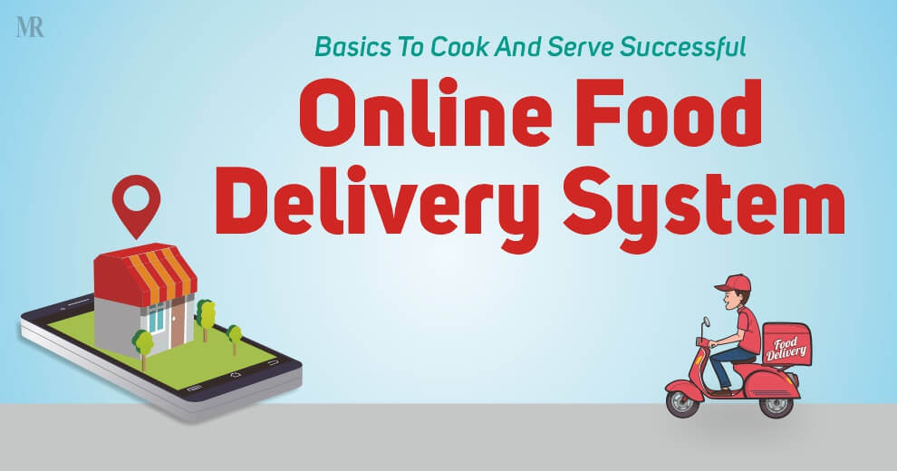
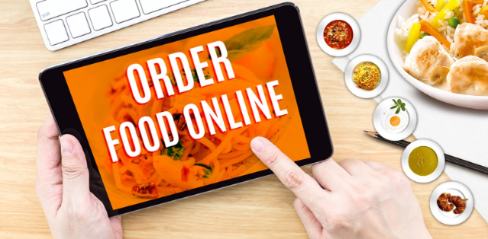

Slide 2
About us
Ahdia Sharifi 4th semester ahdia.sharifi555@gmail.com
Elaha Samadi 4th semester Elaha.samadi37@gmail.com

Slide 3

About us
Ahmad Seerat Sahak Peroz 4th semester of BCS sirat.peroz@gmail.com

Slide 4

About us
Ahmad Millad Niazi 4th semester of BCS milladkhanniazi22@gmail.com

Slide 5
Table of content
Abstraction
Purpose
Data flow diagram (DFD)
Problem statement
Proposed system
Scope and advantages
Future work
Diagrams
Activity diagram
Entity relationship diagram (ERD)

Slide 6
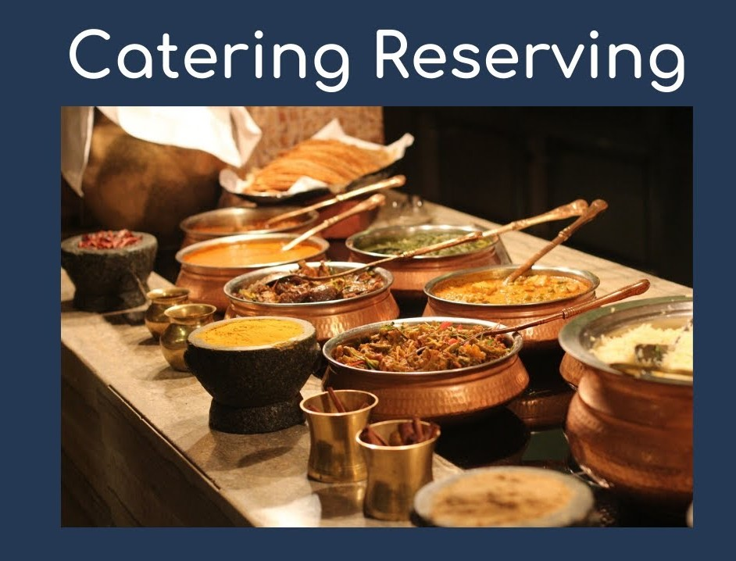
Abstract
Online Food Ordering System is a website which is designed to use in the food delivery industry. This system will allow hotels and restaurants to increase scope of business by reducing the labor cost involved in the activities of a restaurant.

Slide 7
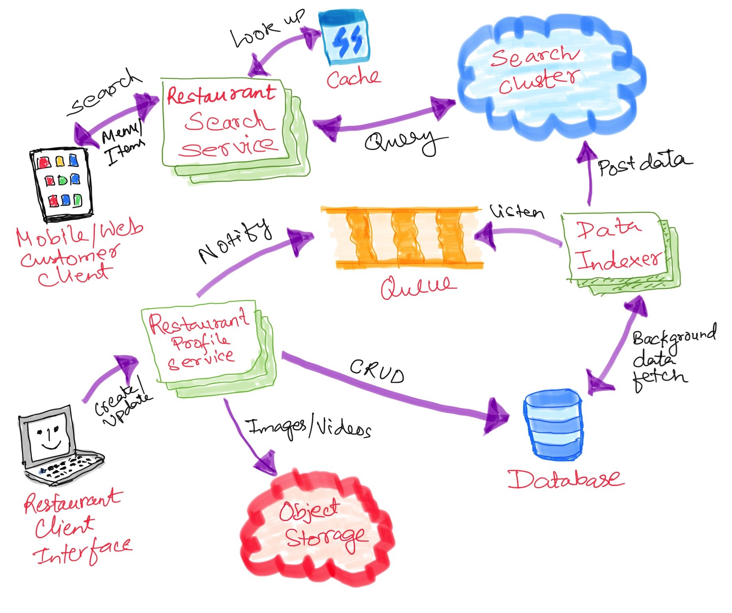
Purpose
The purpose of Online Food Ordering System is to automate the purchase of foods in restaurants or hotels. It will bring manageability in operations done in restaurants. It has many benefits as you can have the records of each orders, you can easily check your income and expenses etc. It is use in restaurants and hotels to accelerate the process of purchasing with exact report of each purchase/food order.

Slide 8
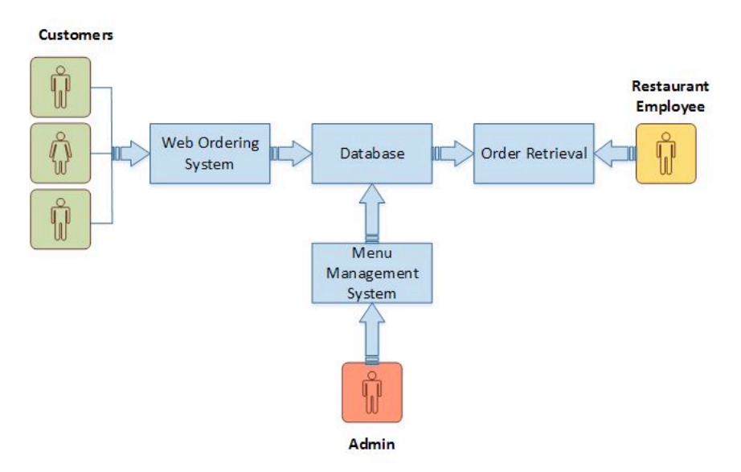
Diagrams Data Flow Diagram (DFD)

Slide 9

Problem Statement
The current system in restaurants are paper based or they have an automate system for them but still they get dissatisfaction of their customers and it is because that most of the customers do not like waiting for long in the store or to have to call store to place an order especially during the peak lunch or dinner hours and some might have problems in going out side for dinner or lunch specially in this situation that we have bad security along with Covic-19.

Slide 10
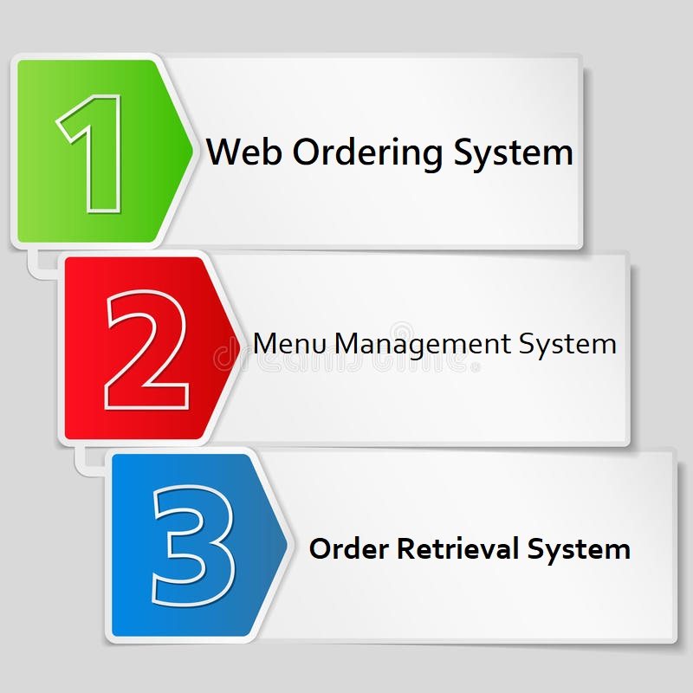
3 Logical Modules
Web Ordering System
Menu Management System
Order Retrieval System

Slide 11

Web Ordering System
Web Ordering System- provides the functionality for customers to place their order and supply necessary details.

Slide 12
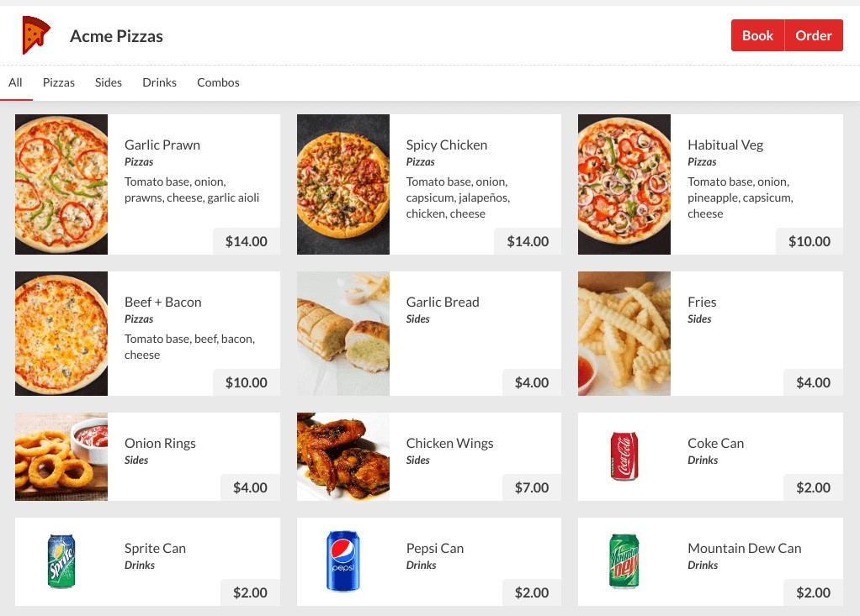
Menu Management
Allows the restaurant to control what can be ordered by the customers

Slide 13
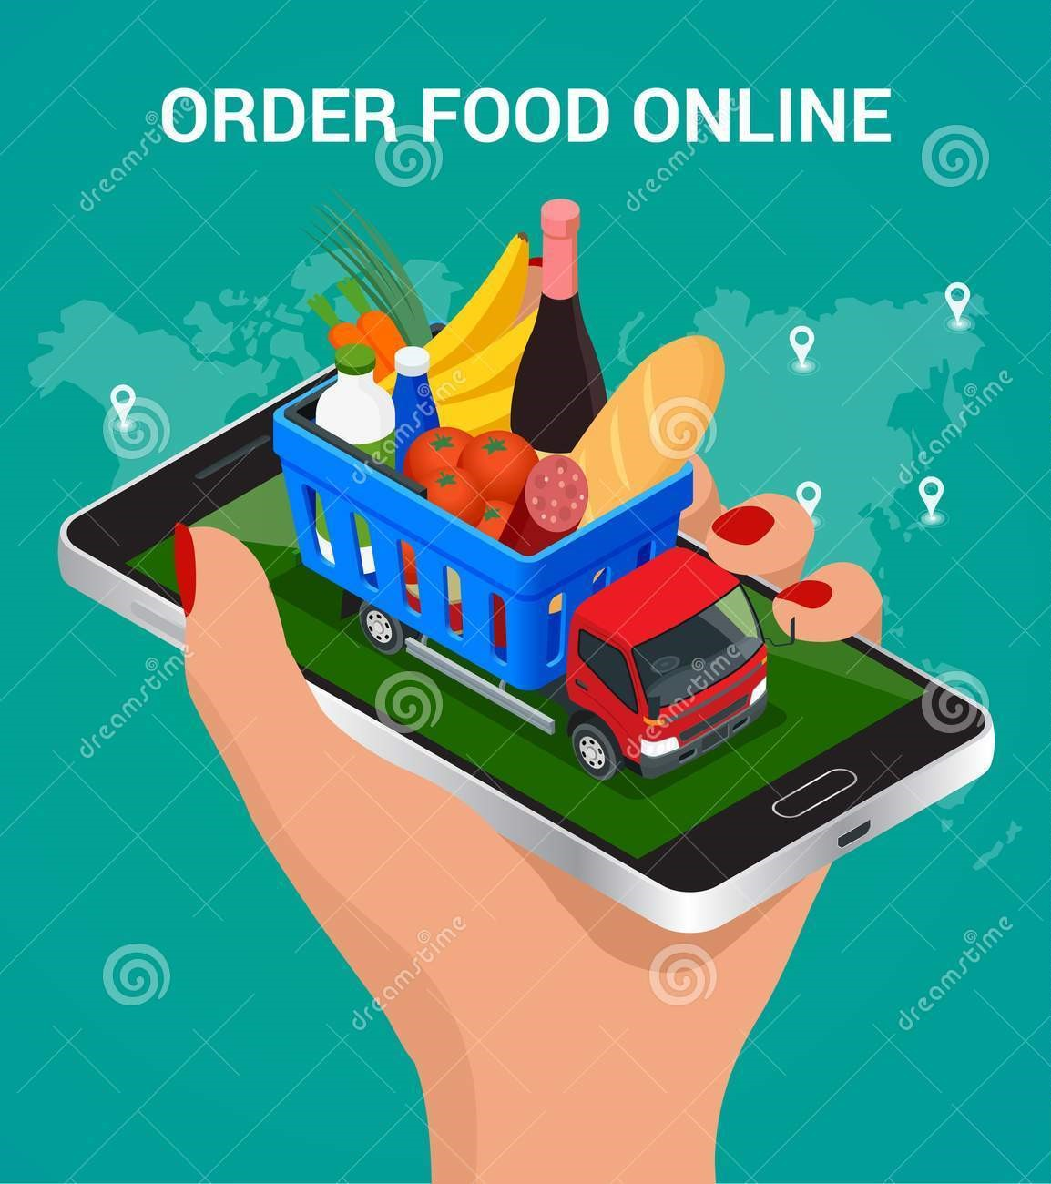
Order Retrieval System
Allows restaurant to keep track of all orders placed. This component takes care of order retrieving and displaying order information.

Slide 14
Web Ordering System Module
Create an account.
Manage their account
Log in to the system.
Navigate the restaurant’s menu.
Select an item from the menu.
Add an item to their current order.
Review their current order.
Remove an item
Place an order.
Receive confirmation in the form of an order number.

Slide 15

Menu Management System Module
This module provides functionality for the power user-Administrator only. It will not be available to any other users of the system like Restaurant Employees or Customers.

Slide 16
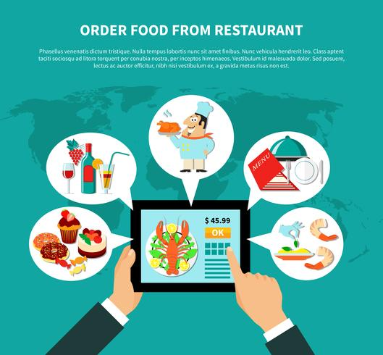
Order Retrieval System Module
This is the simplest module out of all 3 modules. It is designed to be used only by restaurant employees, and provides the following functions:
Retrieve new orders from the database.
Display the orders in an easily readable, graphical way.

Slide 17
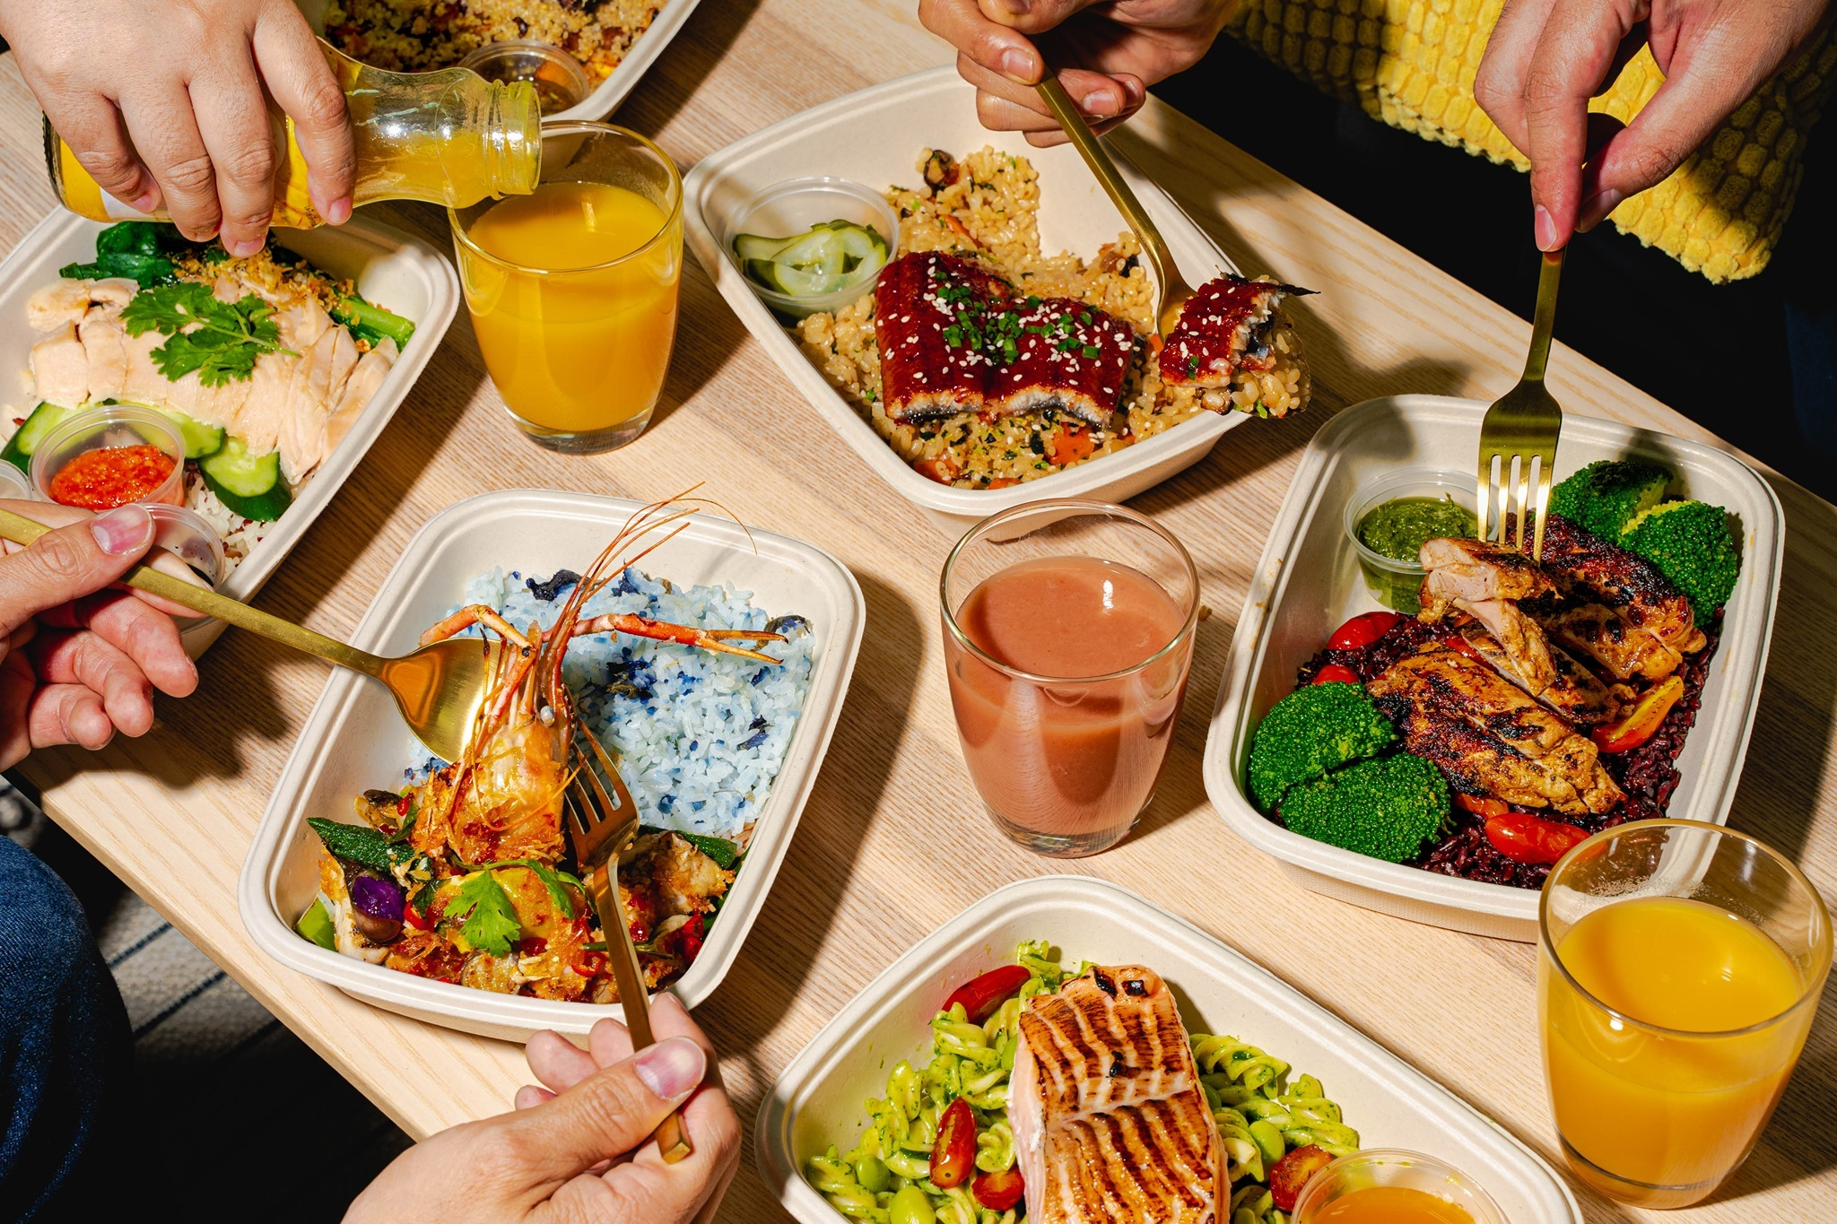
Scope and Advantages
This will minimize the number of employees,cutomer at the back of the counter.
The system will help to reduce labor cost involved.
The system will be less probable to make mistake, since it’s a machine.

Slide 18
Future Work
Customize orders: Allow customers to customize food orders
Enhance User Interface by adding more user interactive features.
Payment Options: Add different payment options such as PayPal, Cash, Gift Cards etc. Allow to save payment details for future use.
Allow to process an order as a Guest
Delivery Options: Add delivery option
Order Process Estimate: Provide customer a visual graphical order status bar
Order Status: Show only Active orders to Restaurant Employees.
Order Ready notification: Send an Order Ready notification to the customer
Restaurant Branch Locator: Allow to find and choose a nearby restaurant
Print Reports (Daily, Monthly….)

Slide 19
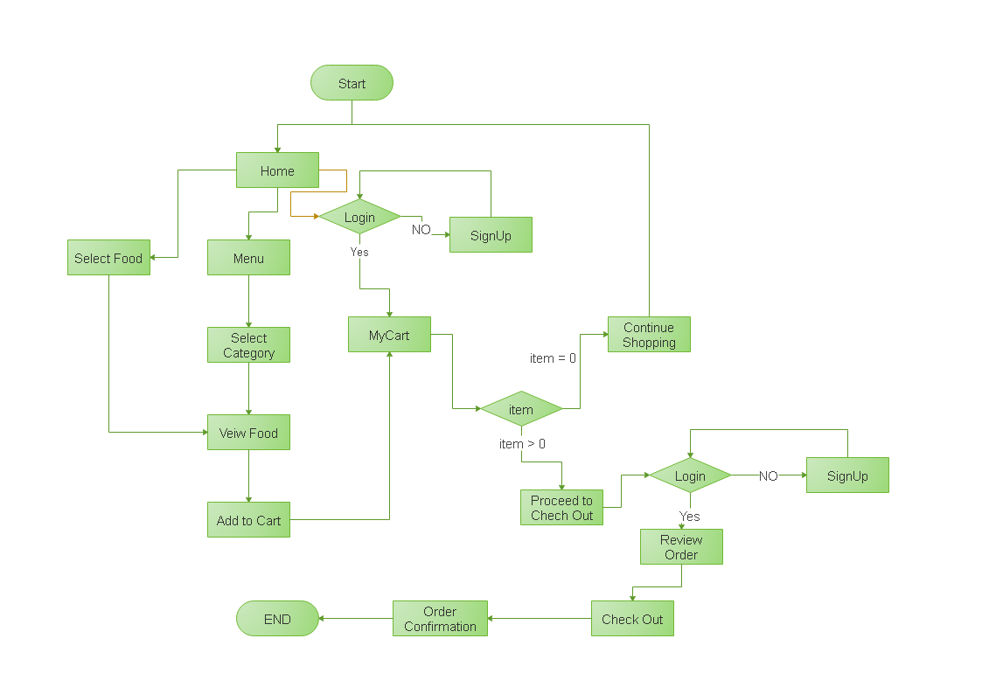
Activity Diagram

Slide 20
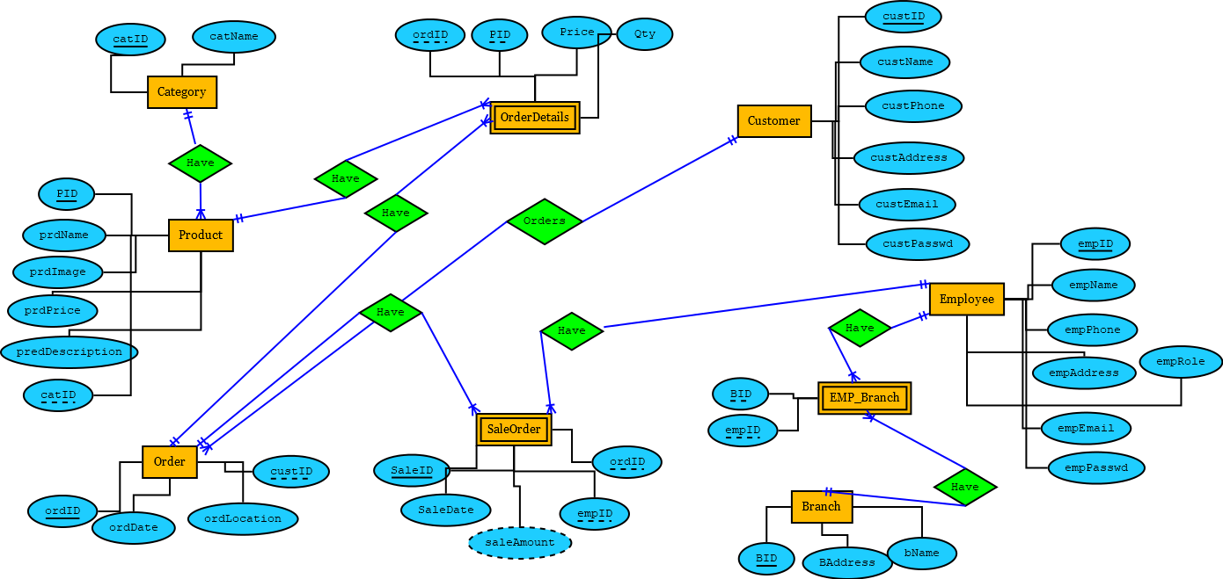
Entity Relationship Diagram (ERD)

Slide 21
Thank you

